Slide 1
DevOps Introduction

Slide 2
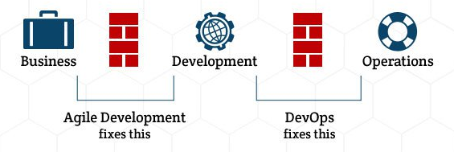
Pain Points
The pain points IT experiences in response to business change
What business users expect from IT:
Flexible and quick response to business changes
The pain points IT experiences
attempting to meet the expectation:
Manual build and deployment
More lead time manual testing
Post-delivery quality issues exposed to end users
What IT needs to do:
Automatic build and deployment
Less testing time
An easier way to find the defects ahead of the users

Slide 3
DEVOPS Services
A practical code production line
Automated Testing
Automated Monitoring
Development
Continual Integration
Continual Deployment
A practical DEVOPS product line can help us:
To maintain integration & deployment in lower operation cost.
To release human resources from robotic tasks to more creative activities.
To detect the defects as earlier as possible to keep production deployment safer.

Slide 4
DEVOPS Tooling
How to automate the code production line
Before trying to implement DEVOPS…
Establish an Agile working culture, putting DEV and OPS together
Learn about all the different DEVOPS tools
Acquire computers or virtual machines with enough power to support your DEVOPS work
Jenkins
J-meter
Ansible
Nexus
GIT
Selenium
JIRA
RPM
Sonarqube
When implementing DEVOPS…
Select the suitable tools
Build a foundation, you don’t need to implement all the steps at once. Implement 1 or 2 functions, build solid connections between them.
Implement and improve the workflow

Slide 5







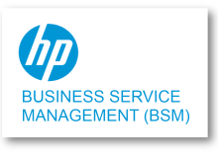






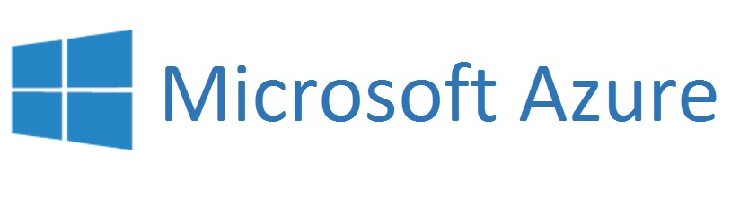








DevOps Tools will be different
Application Development
Operation Management
Scrum Management
Develop-ment
Testing & Code Scan
Source Code Management
Continuous Integration
Application Deployment
Knowledge Management
Environment Provisioning Maintenance
Application Monitor, Alert
Service Management
Service Dashboard
R&D Practices for ACOS
Jira | Eclipse | Selenium, Jmeter, SonarQube | Gerrit | Jenkins | Nexus, Ansible | Confluence | Openstack, Bash | Nagios | HPSM, Jira | BSM, Monitor Dashboard*
Microsoft Practices for EDP(Under Construction)
VSTS - Work, TFS | Visual Studio 2016 | VSTS - Test, UFT, LoadRunner SonarQube | VSTS - TFVC, GIT | VSTS - Build | VSTS, PowerShell | SharePoint, MediaWiki | Azure Portal, PowerShell | Azure Portal | SNOW | Troux, Monitor Dashboard*

Slide 6



DevOps Pilot in R&D Domain
1.Agile Working
2.Continues Integration
3.Deploy to INT
4.Automate Testing
5.Deployment
1
2
Approve/Reject
Auto pack
Code is committed to Git
Peer review by senior developers using Gerrit. Code is pulled directly from GIT branch
Code merged to master in Git project
Nexus Repository Manager
Code written & committed locally in Eclipse
Jenkins begins automated build & deploy process
View code coverage results in Sonar
Auto Deploy
Code Review Report
3
4
Automate/Performance Testing Report
Documentation
Run book
Knowledge sharing
Deployment steps
Support Deployment
Defects automatically logged on JIRA
Automated Functional Testing using Selenium
Performance testing using JMeter
INT Environment
5
Service Availability Monitor
Prod Environment

Slide 7

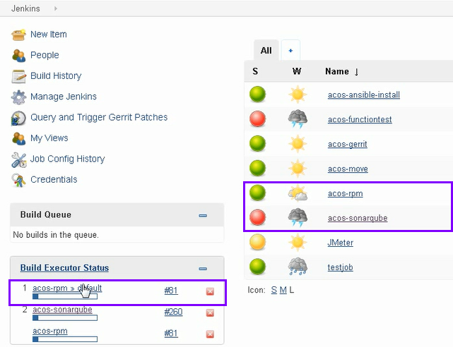
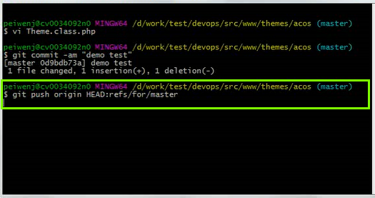
Step 1: Build
Click to watch the demo
DEVOPS automatically performs code specification detection (SonarQube)
DEVOPS automatically builds packages (Jenkins, RPM) at same time
Developers push daily code to code repository for review (Git, Gerrit)

Slide 8
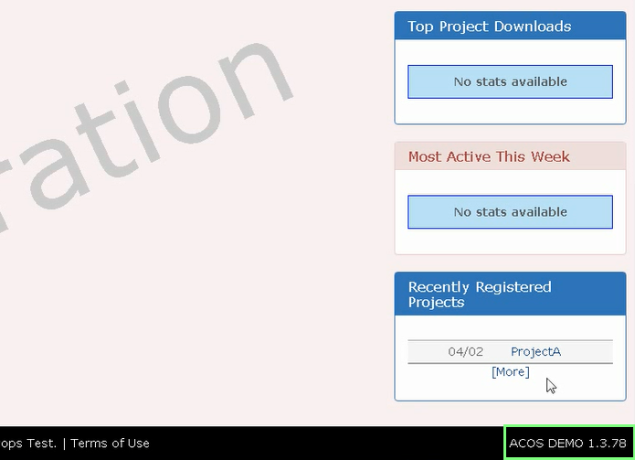
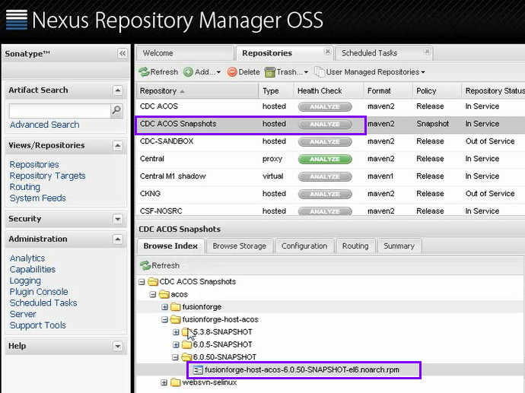
Step 2: Deploy
DEVOPS uploads packages to artifact management tool (Jenkins, Nexus)
Click to watch the demo
Deploy packages are installed automatically on target server (Jenkins, Ansible)

Slide 9
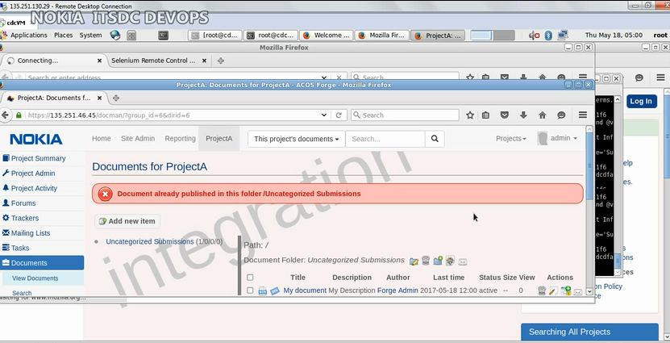
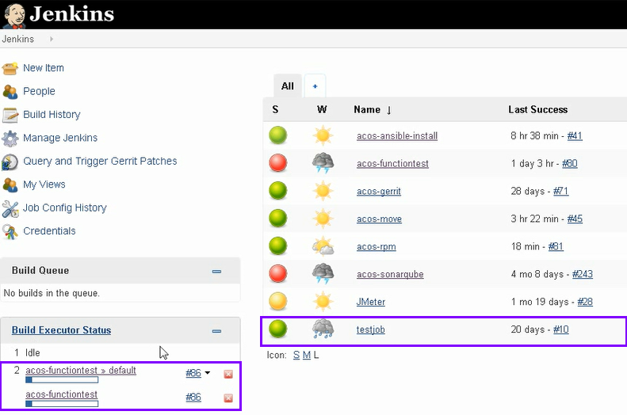
Step 3: Test
Click to watch the demo
DEVOPS performs automatic functional test on target servers (Jenkins, Selenium)

Slide 10
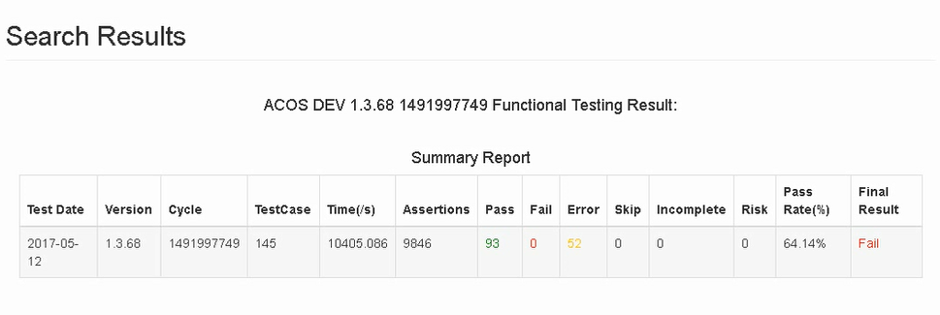
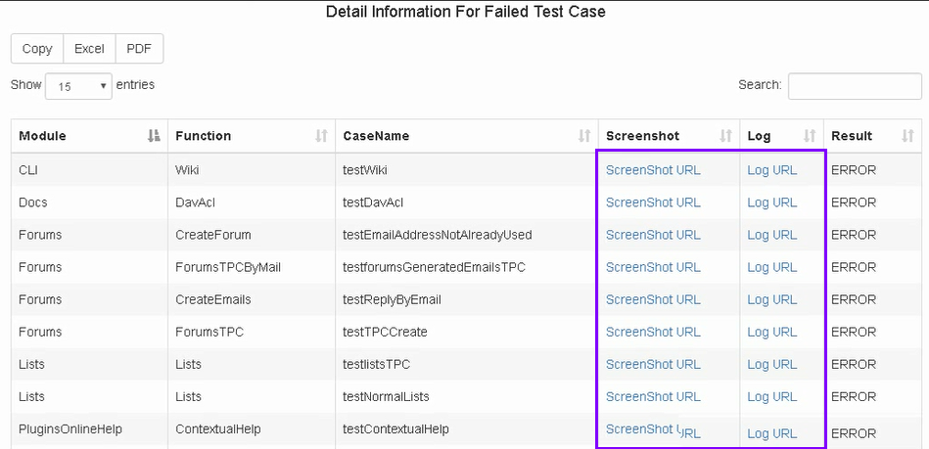
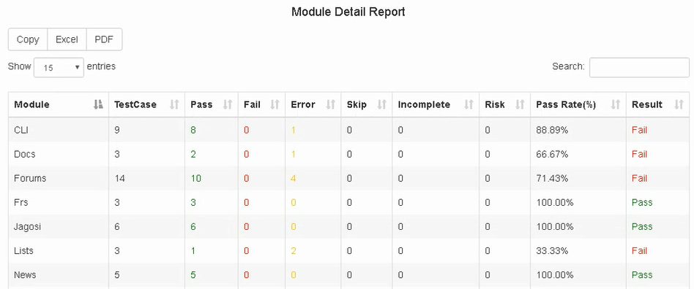
Step 4: Report
DEVOPS does test result data analysis (Jenkins)
Click to watch the demo
Screenshots and logs can be tracked in dashboard
Dashboard displays the test results (pass, fail, error status for each test case)

Slide 11
DEVOPS Summary
Summary and next steps
Summary
The current DEVOPS product line can realize a good vision that to integrate and deploy new changes in weekly(at least) to answer flexibly end users 'requirements while in a lower quality failure cost compared to traditional development approaches.
Next steps
DEVOPS knowledge research and transition.
E2E mgmt. from demand mgmt. to defect mgmt.
DEVOPS governance mode establishment and maintenance.

Slide 12
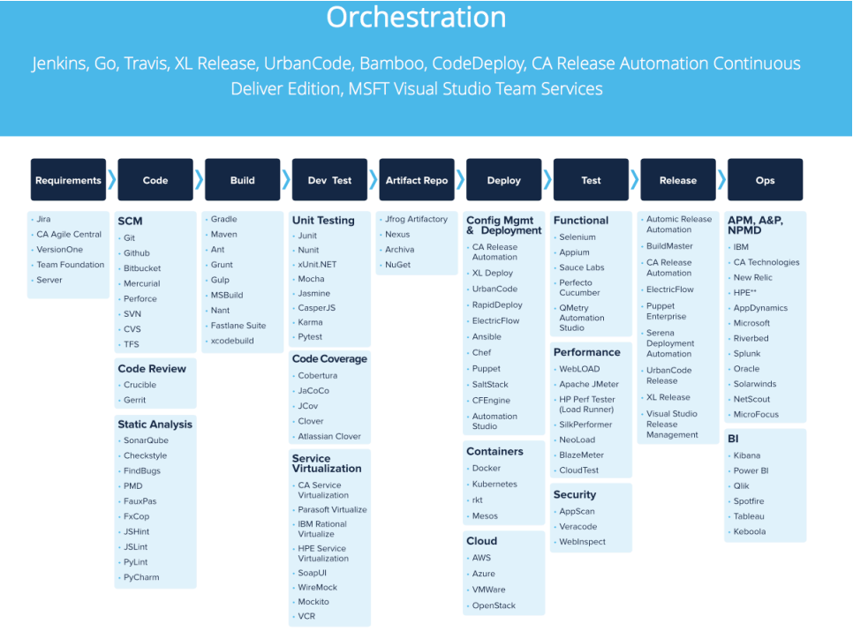
工具链参考

Slide 13
Kubernetes
Kubernetes Introduction:
http://docs.kubernetes.org.cn/227.html
http://www.dockone.io/article/932
JD example:
https://www.kubernetes.org.cn/4293.html
From traditional to K8s:
https://www.itcodemonkey.com/article/4261.html

